Slide 1

UNIVERSITI
MALAYSIA
SARAWAK
Community-Driven University For a Sustainable World

Slide 2
UNIVERSITI
MALAYSIA
SARAWAK
Community-Driven University For A Sustainable world

Slide 3

Community-Driven University For a Sustainable World

Slide 4
OUR VISION
A leading global university for a sustainable future
OUR MISSION
To enhance the social and economic impacts on the global community through the pursuit of excellence in teaching, research, and strategic engagement

Slide 5
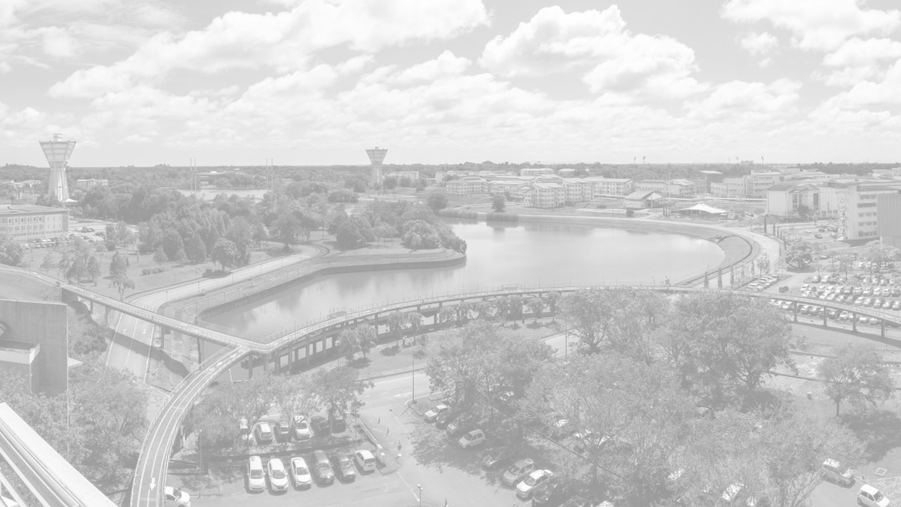


V A L U E S
O U R
E X E M P L A R Y
C O L L E G I A L I T Y
I N T E R G R I T Y
L o r e m i p s u m d o l o r s i t a m e t , c o n s e c t e t u e r a d i p i s c i n g e l i t ,
s e d d i a m n o n u m m y n i b h e u i s - m o d l a o r e e t d o l o r e .
L o r e m i p s u m d o l o r s i t a m e t , c o n s e c t e t u e r a d i p i s c i n g e l i t ,
s e d d i a m n o n u m m y n i b h e u i s - m o d l a o r e e t d o l o r e .
L o r e m i p s u m d o l o r s i t a m e t , c o n s e c t e t u e r a d i p i s c i n g e l i t ,
s e d d i a m n o n u m m y n i b h e u i s - m o d l a o r e e t d o l o r e .
T E N A C I T Y
E Q U I T Y
L o r e m i p s u m d o l o r s i t a m e t , c o n s e c t e t u e r a d i p i s c i n g e l i t ,
s e d d i a m n o n u m m y n i b h e u i s - m o d l a o r e e t d o l o r e .
L o r e m i p s u m d o l o r s i t a m e t , c o n s e c t e t u e r a d i p i s c i n g e l i t ,
s e d d i a m n o n u m m y n i b h e u i s - m o d l a o r e e t d o l o r e .
E x C I T E

Slide 6
A C H I E V E M E N T
+ A W A R D
QS
S T A R S
T H E
MyRA

Slide 7





A B O U T U N I M A S
UNIMAS is a Community-Driven University
S U B T I T L E
T E X T
S U B T I T L E
T E X T
S U B T I T L E
T E X T

Slide 8
I N F O G R A P H I C
4 3 5 6
T E X T
2 1 6 4
T E X T
2 5 %
5 0 %
7 5 %
TEXT
TEXT
TEXT
5 9
O P T I O N 1
O P T I O N 1
O P T I O N 2
O P T I O N 3
2 3
O P T I O N 2
1 4
O P T I O N 3

Slide 9



I M A G E
T E X T
T E X T
T E X T
FOLLOW | LIKE | SHARE
#UNIMASoﬃcial

Slide 10
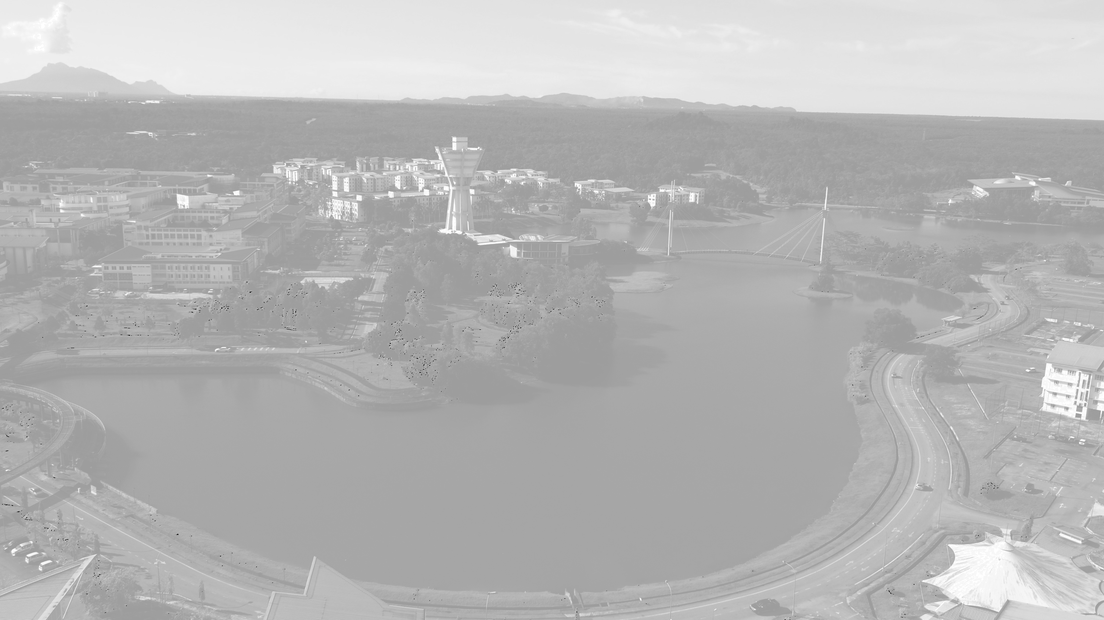

BUKU POKOK
1993 | THE UNIMAS BLUEPRINT

Slide 11

Contemporary and
Forward Looking

Slide 12
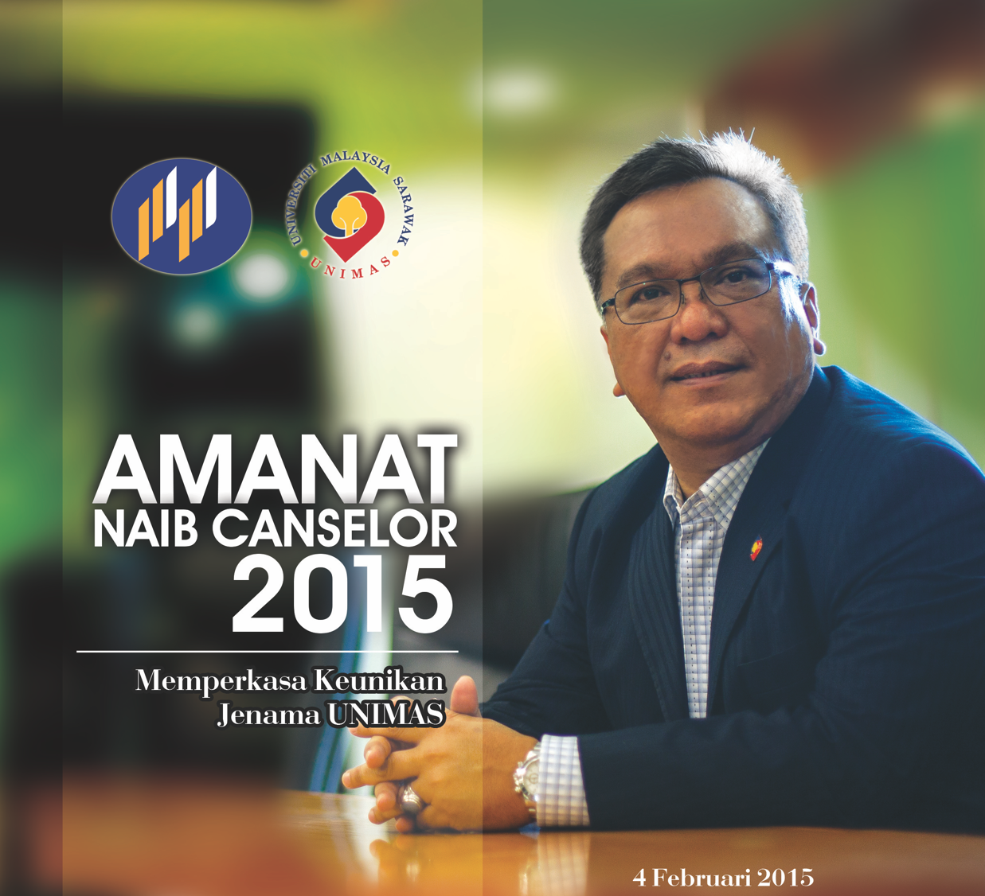
Memperkasakan
Keunikan
Jenama UNIMAS

Slide 13
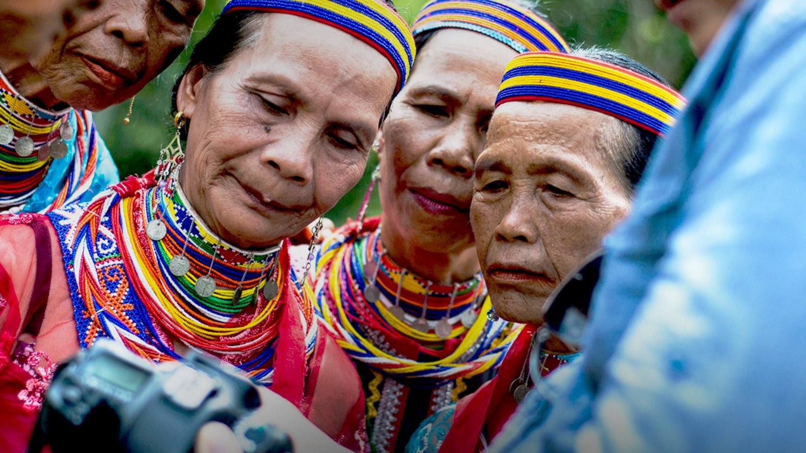
Sustainability
For Diversed &
Dispersed
Communities

Slide 14
OUR VISION
A leading global university for a sustainable future
OUR MISSION
To enhance the social and economic impacts on the global community through the pursuit of excellence in teaching, research, and strategic engagement

Slide 15
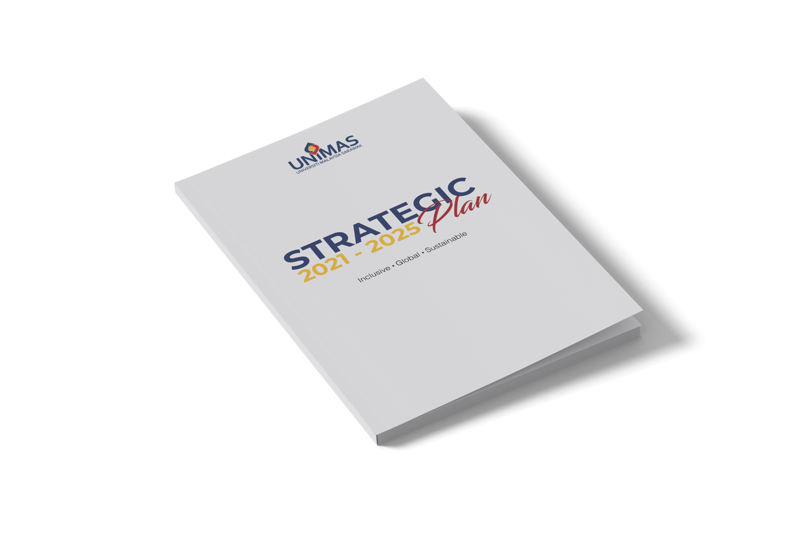
STRATEGIC
PLAN
2021-2025

Slide 16
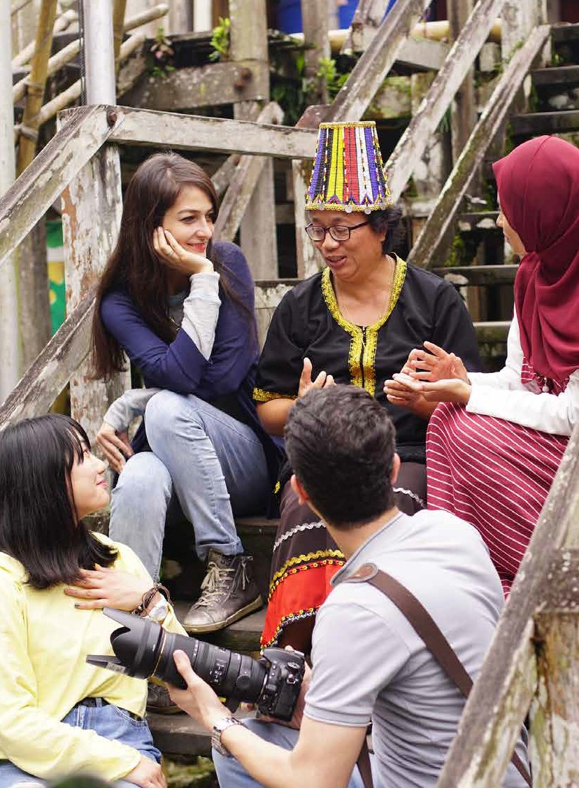
Community
Driven
University
for a
Sustainable
World

Slide 17

We Are
located in the heart of Borneo – the world’s richest site for biodiversity and indigenous knowledge, UNIMAS is a prominent global player in empowering communities, nurturing creativity and pioneering innovation for a sustainable world

Slide 18

BrandFocus
Borneo
Biodiversity
Indigenous Knowledge
Empowering Communities
Nurturing Creativity
Pioneering Innovation
Sustainability

Slide 19
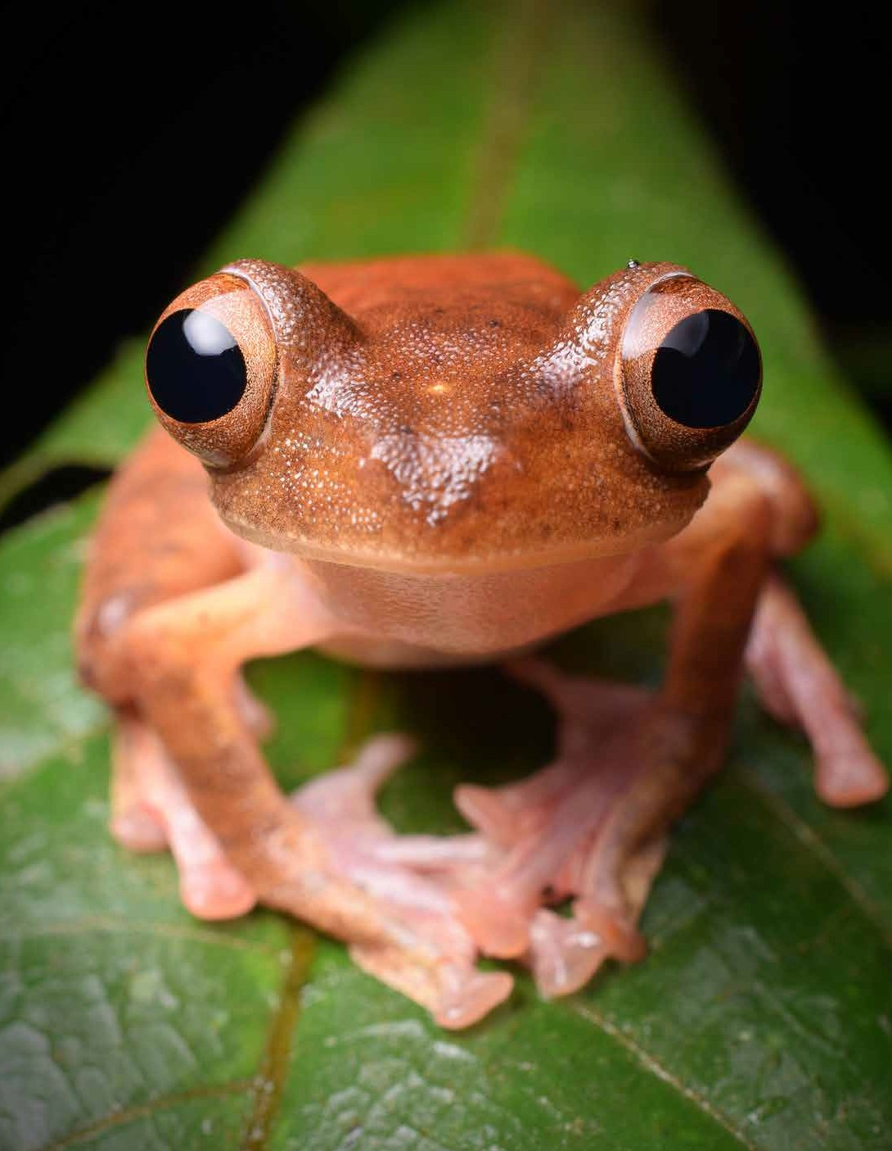
Brand Visual
is about
PROMISE
DELIVERY
SUSTAINABILITY

Slide 20

UNIMAS
BRAND
MANUAL
A manual that would provide guidelines as to how we project our brand to the world

Slide 21


Slide 22
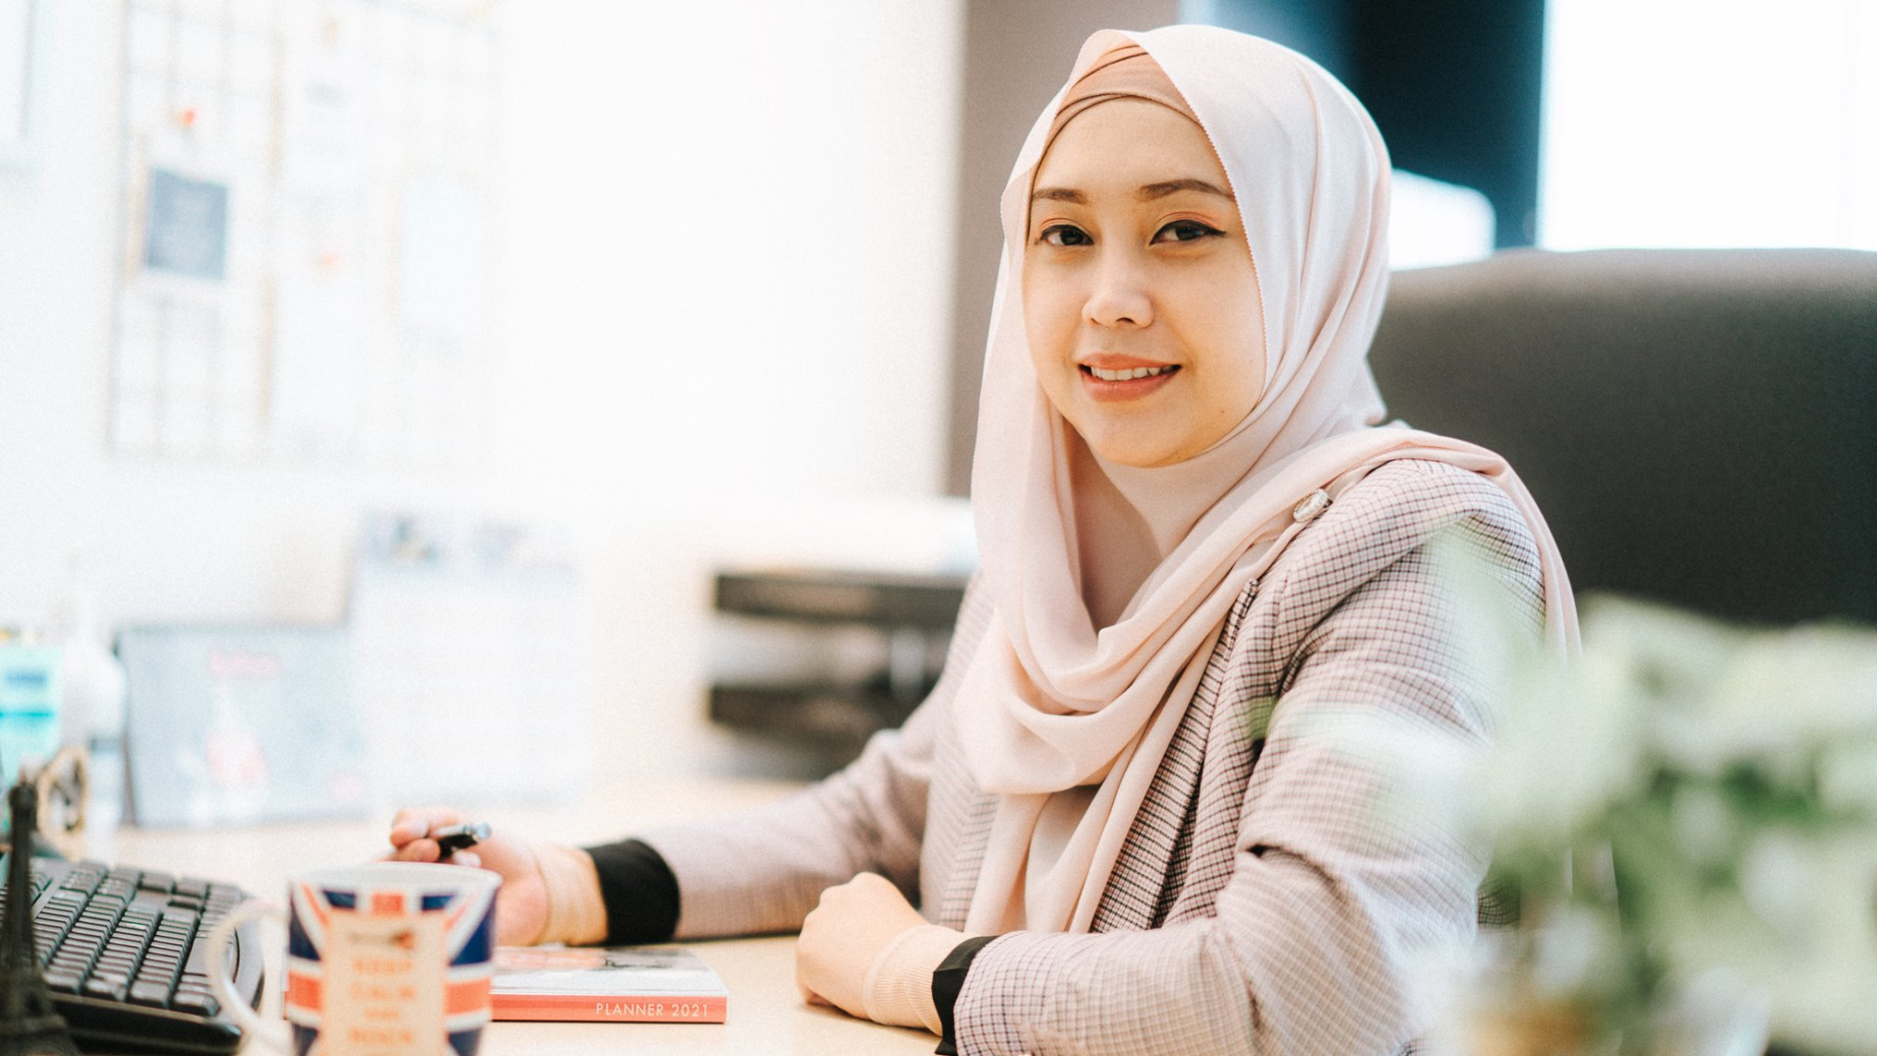
Establishment
of PTj’s
Branding Unit

Slide 23
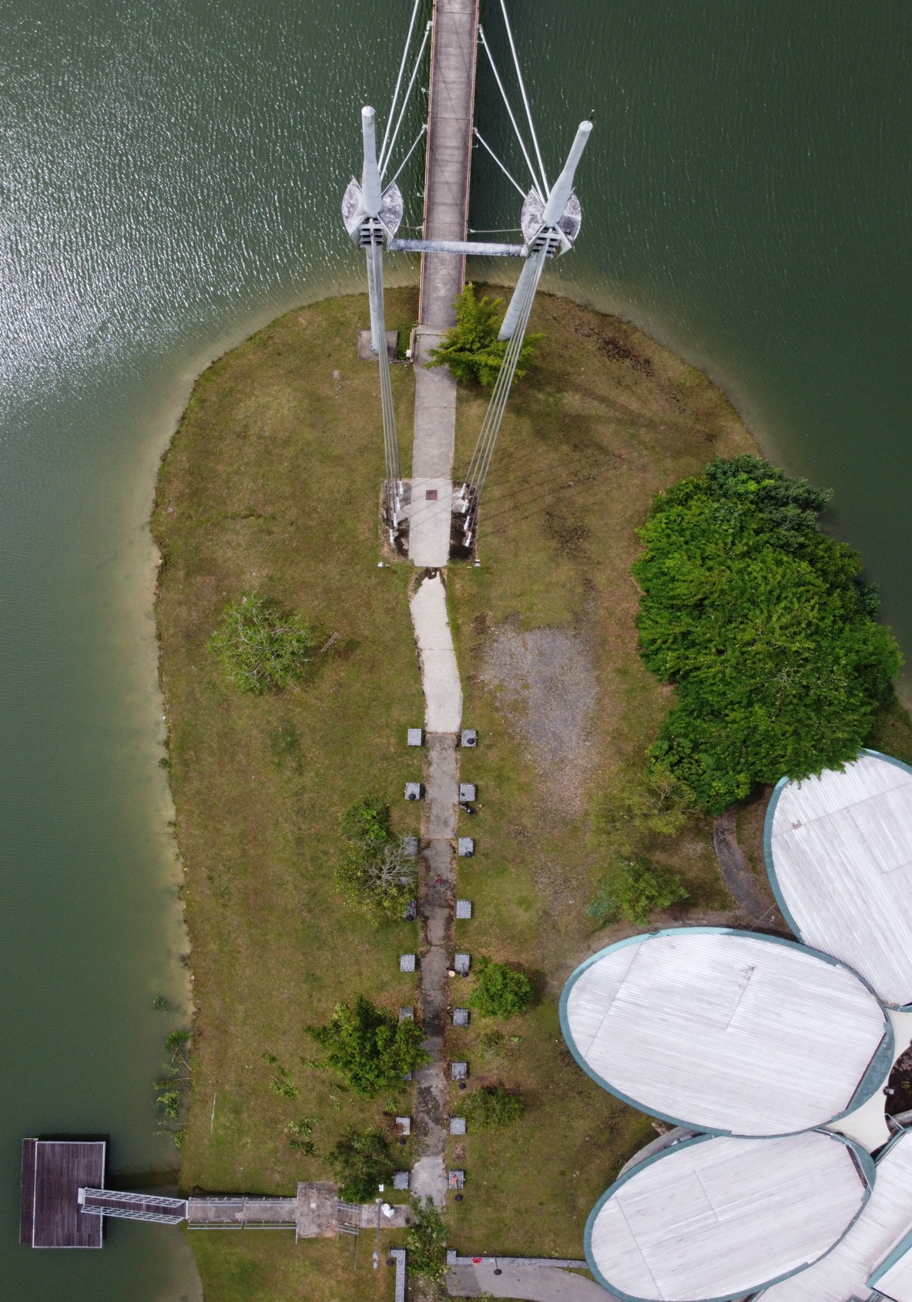

Slide 24
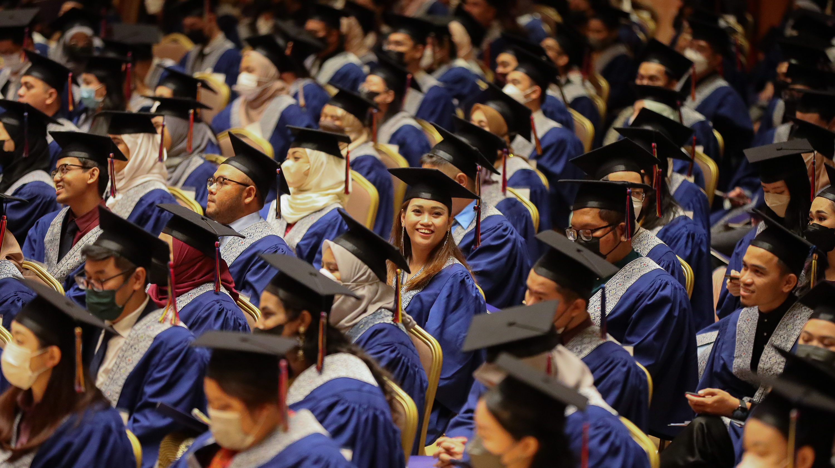
TERIMA
KASIH

